Slide 1

Blinkit Sales Analysis
Data-Driven Insights for Retail Growth

Slide 2

OVERVIEW
Project Snapshot
Domain
Tools
Dataset
Retail & E-commerce Analytics
Python, Pandas, NumPy, Matplotlib, Seaborn
8,523 transactions analyzed

Slide 3
Key Performance Metrics
₹1.2M
₹141
8,523
3.97
Total Sales
Avg Sale/Item
Items Sold
Customer Rating
Strong revenue performance
Consistent pricing
Transaction volume
Out of 5 stars

Slide 4

PRODUCT ANALYSIS
Top-Performing Categories
Fruits & Vegetables
Highest revenue driver
Snack Foods
Strong consistent demand
Household Items
Essential category performer
Key Finding: Limited categories drive majority of sales (Pareto effect)

Slide 5
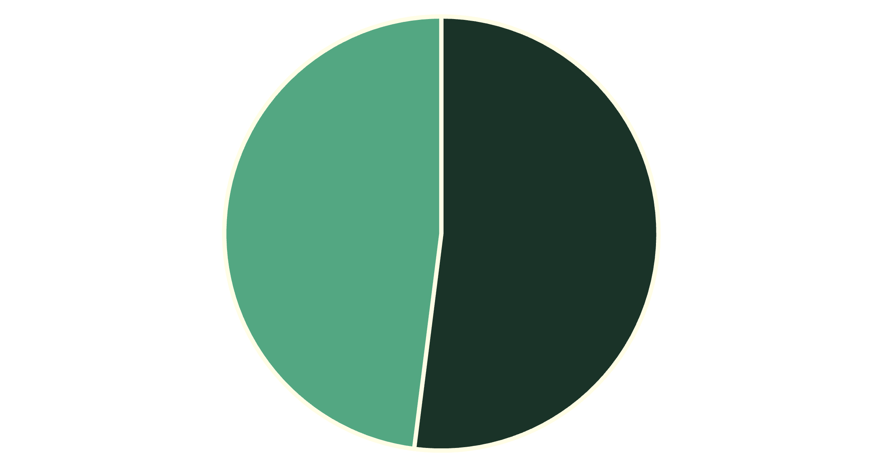

Fat Content Balance
Balanced Customer Preferences
Both Low Fat and Regular items contribute significantly to revenue.
No extreme dependency on single category indicates diverse customer base.
Strategic Insight: Maintain both health-focused and regular products for revenue stability
Low Fat
Regular

Slide 6

Outlet Type Performance
Supermarket Type 1
Supermarket Type 2
Grocery Stores
Highest total sales
Strong performance
Lower revenue
Better assortment drives spending
Customer trust and availability
Limited product range

Slide 7



CRITICAL FINDING
Medium Outlets Win
Best Balance
Medium-sized outlets generate highest sales, exceeding both small and large formats
1st
2nd
3rd
Medium Outlets
Small Outlets
Large Outlets
Optimal variety + efficiency
Limited selection
Diminishing returns
Large outlets show higher operational costs without proportional revenue gains

Slide 8

Location Performance Analysis
Tier 2 Cities Lead
Semi-urban markets are Blinkit's strongest growth drivers
Highest sales contribution
Strong purchasing power
Less market saturation
Growth opportunity
Followed by: Tier 3 locations, then Tier 1 metros

Slide 9





RECOMMENDATIONS
Strategic Action Plan
Expand Medium Outlets
Target Tier 2 Cities
Optimize Inventory
Enhance Experience
Increase marketing and delivery reach in semi-urban areas
Boost stock for top categories, reduce low-demand items
Focus on medium-sized formats for maximum ROI
Faster delivery, quality consistency, improved packaging

Slide 10

Path Forward
Python-based analysis transforms raw retail data into actionable business insights
₹1.2M+ Revenue
Clear Patterns
Strong foundation
Data-driven direction
Growth Ready
Scalable strategy
Implementing these recommendations will improve profitability, operational efficiency, and long-term scalability

